Slide 1
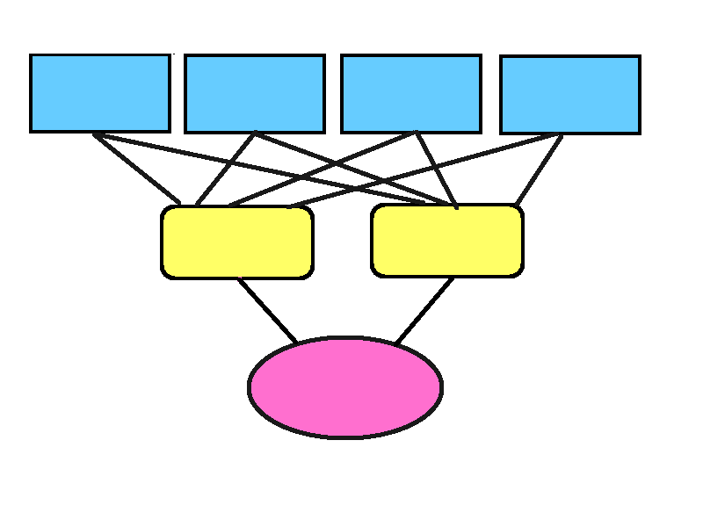
A model for Re-categorization by: Tim Sparer

Slide 2
The Big Question
Our Environment is always changing, but to make sense of it, and (evolutionarily) to survive, we infer patterns and form theories to predict its workings. How do we (dynamically) modify those theories as circumstances change?

Slide 3
A Motif:
When is environmental change “just noise”, and when is it “meaningful” in terms of updating our theories? How can we tell the difference?

Slide 4
The Medium Question
Category formation (and change) can be a proxy for broader conceptual change: Compressing a set of features into a broader category (given feedback) might be analogous to theory formation.
(E.g. “Features X and Y predict membership in Category Z”)
Notes:
Evolutionarily salient example: theCategory of (aversive) dangerous things might include things with features like spines and sharp pointy teeth

Slide 5
The Experimental/Modeling Question
Given an experiment on Re-categorization (here-after “the Recat task”), is there a plausible, generalizable model to account for subjects’ (re)categorization behavior?

Slide 6
The experiment: part 1
Subjects complete a basic inductive learning/categorization task
“Martian Bacteria Classification”
1. Subjects are given a set of features, each of which has two possible values, and told that these map to a specific category (“whether or not they confer oxygen resistance to martian bacteria”), but are not told which features define the category. The task is to learn which features define the category (confer oxygen resistance)..
2. Over a series of trials, subjects view a collection of features/values (“the martian bacterium”), and are told to guess whether or not this example is in the relevant category. After guessing, they are provided feedback. (“the bacteria was (not) oxygen resistant”).
3. Participants provide feedback in the form of confidence judgements (after trials), and periodic importance ratings on features.

Slide 7
Martian Bacteria, with features. Is this oxygen resistant, or not?
What features confer Oxygen Resistance?

Slide 8
Experiment Part 2
Re-categorization
1. After successfully learning the category definition (judge by performance at criterion); Unbeknownst to subjects the feature-value → category mapping is changed. A new set of features now define the category “oxygen resistance”.
2. The experiment proceeds as before.
3. (This is isomorphic to the Wisconsin Card Sort Task)(?)

Slide 9
Possible IVs
Complexity
Feedback type/amount
(…)

Slide 10
Possible DVs
Percent consistent with original conception.
Percent consistent with new conception.
Trials to criterion.
Reaction times.
Confidence ratings.
Feature importance ratings.

Slide 11
(Weird) Findings of Note, that a Model should explain.
1. Perseveration: People tend to persist in the old category definition, even after confronted with disconfirming evidence.
Importance Ratings: Initial importance ratings tend to rate the features for the original definition higher than all the others (intuitive). After Re-categorization however, importance ratings do not (well) reflect the importance of the new feature. Participants importance ratings are all over the place (not-intuitive).
Complexity: People find it hard to learn an initial complex category, but easy(ier) to switch to one, given a simple initial definition. (Even though the switch is not consistent with the simple cat.)
Reaction Time: Reaction times are actually faster after the switch, and display a weird “scalloped” pattern.

Slide 12
Model might explain some weird findings: (in order of strengh of model explanation, so far)

Slide 13
Example importance ratings

Slide 14
Example Complexity

Slide 15
Example Reaction Times

Slide 16
Desirable Model Characteristics In addition to explaining the data, an ideal model should be:
Biologically Plausible
Mathematically Normative

Slide 17
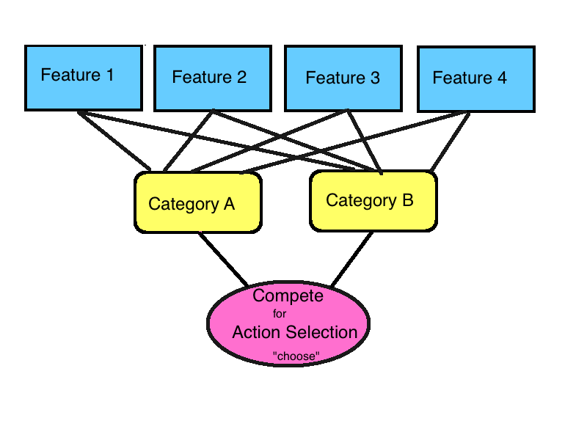
Model: Intro (static view) (M binary features x N binary categories) compete for one binary output channel

Slide 18
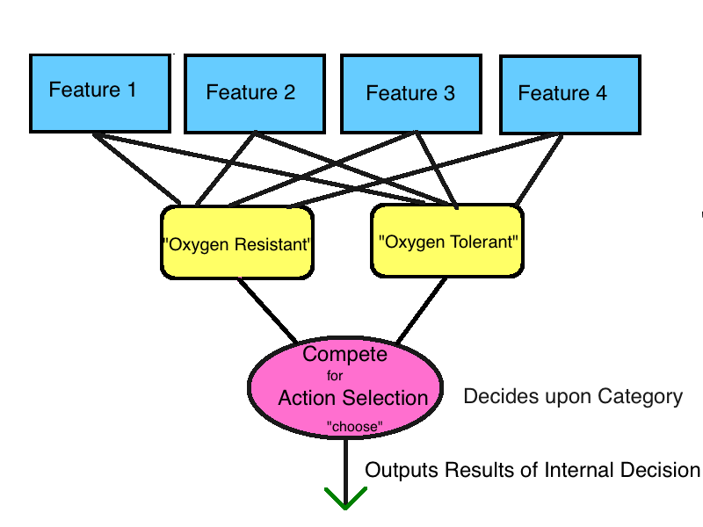
Note: Categories are defined independent of one another: Therefore the category “Oxygen Resistance” from the recat task, is, for the model, recoded as two separate categories: Oxygen Resistance and Oxygen intolerant

Slide 19
Why Recode Categories?
Behaviorally plausible(?). People do not seem to define things by their negation: Cats are not defined as “not dogs”. (The class of things that something “is not” is potentially infinite. (future experiment on this perhaps?))
People generally have a more difficulty learning negations. (See for example, Feldman, 2000 Minimization of Boolean complexity in concept learning).
Allows for “fuzzy” category membership. (Wittgenstein, others), and “shared parts”. (Category definitions can overlap due to shared features).
Allows Model to be extended to an arbitrary number of categories.
Notes:
Negation: all sorts of things I am not: a chair, a koala bear, a true american hero…

Slide 20
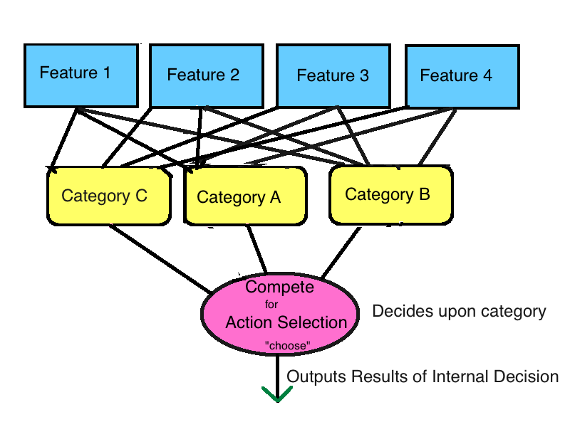
Example model with 3 categories
Notes:
Maks model

Slide 21
The Model: 2 Key functions
Categorizing an instance based on past experience.
Updating the model, given feedback from a categorization attempt
Notes:
“updating” ….. learning

Slide 22
The Model in action
Instance Categorization:
1. Observe instance, activate feature values.
2. From observed features, calculate the independent likelihoods for each category (based on past experience).
3. Weigh category likelihoods relative to each
other.
4. Select most probable category. Output resulting decision.
Update:
1. Receive feedback.
2. Update Category membership (based on errors).
Notes:
Category membership definition of category

Slide 23
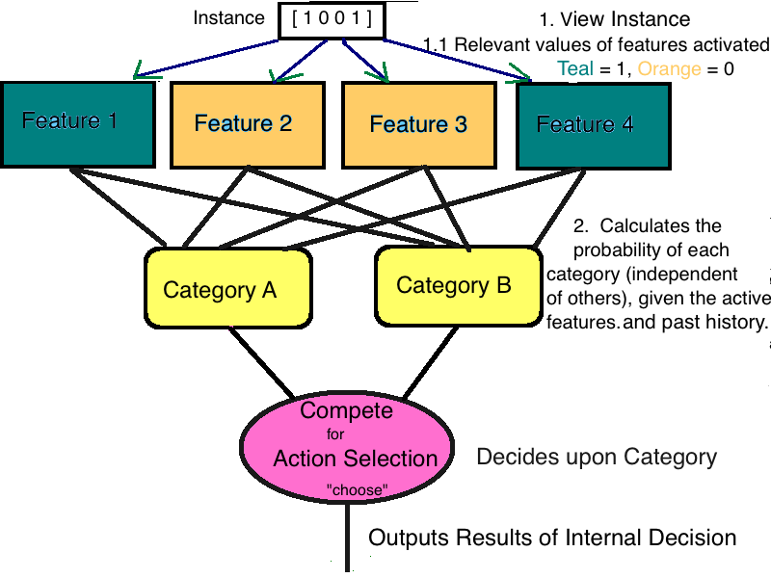
The Model: Guessing Category; step 1 + 2. View instance, activate features

Slide 24
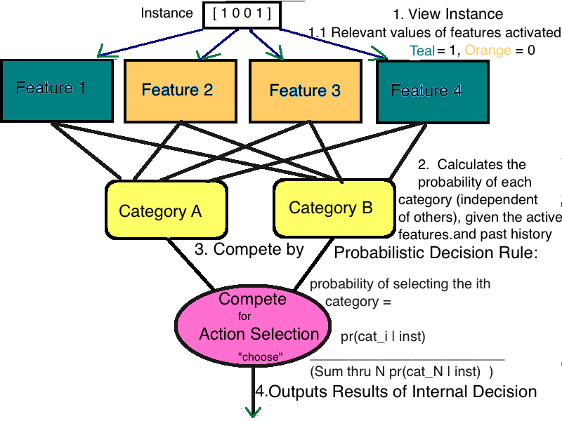
Guessing Category: Steps 3 + 4
Notes:
weight

Slide 25

The model (theory): Category Selection as Bayesian Classification
Bayes Theorem:
Bayesian Classification:
Uses Bayes theorem to choose which category is most probable, given the feature-values.
Presumes features are independent (though often effective extremely even when this is not the case) (See Zhang, 2004).
Multiplies (learned) independent probabilities of features given categories to assess likelihood of category membership.

Slide 26

Model math: features as marginals
Bayes theorem, for categories:
In words:
Likelihood (top term) marginalized over multiple features

Slide 27
Model Math: Marginals with independence assumptions

Slide 28
Model math so far: In words
- For each category, the model presumes that the likelihood of a single feature of each category is independent of both the other features and other category definitions.
- Multiplying the (independent) marginalized likelihoods of the features (predictive of category membership) produces an estimate of the probability of the current instance being a member of the particular category.
Note: In Boolean logic/probability the “and” operator corresponds to multiplication.
But how to select which category!?!
Notes:
Move to previous

Slide 29


Final Category Selection
pr_{out}(C_{x} | F₁ … F_{m}) =
pr_{ind}(C_{x} | F₁ … F_{m})____________________
_{i}Sum^{n} ( pr_{ind}(C_{i} | F₁ … F_{m}) )
Categories compete based on their relative probabilities (similar to biased competition in theories of action selection).
_________________________________________________________________________
Speculation: This may be formally similar to the Gibbs measure in machine learning. If so, the resulting probability distribution (over categories, given the current instance) can be thought of as fitting a log-linear model “in subjects heads”, where the categories serve as predictor variables, the category’s overall probability (given the features, and relative to other categories) is the weight of each variable, and the “predicted quantity” (the Y variable in the log-linear model) is success in categorization.
Gibbs Measure
Log-linear Model
Y =
Notes:
Initially used for thermodynamics, the Gibbs energy is also used in machine learning. It states the probability of a particular “macrostate” (e.g. category?)(arrangement of microsystems (features?)), occuring as a function of their “energy” of the microstates, macrostates requiring more energy = less probable.
(In machine learning, “energy” is usually translated as complexity of representation/ predictive accuracy of representation?)
The Gibbs measure gives the probability of the system X being in state x (equivalently, of the random variable X having value x) as a function of the energy of the state x. States with lower “energy” are more probable.
Each category can be thought of as a state x, whose energy is proportional to its likelihood, given the instance/features currently active. That is exp(-B E(X)) = likeli(C | F…) . (The exponential term in the Gibbs measure is equal to the likelihood of the category given F)
The 1/z(B) term is the normalizing constant (makes everything equal to one), and is equal to the sum over all category likelhoods in our model.
(z(B)Canonical ensemble)
Beta (in Gibbs measure/machine learning) is often taken to measure inverse temperature, in some machine learning applications (E.g. anatomy of decision), this is used to encode the variance of the environment/ (variance of) success of one’s actions. (See also work on quantal response equilibria)
Linear model:
Since the final (normalized) probabilities of states x (categories) of the system are exponentials, and our model is multiplicative (“Ands” multiply), we can multiply the Gibbs measures for all states and combine terms (the exponents add, the normalized part pulls out in front)- to get some thing that looks a log-linear model.
Why do we care? Log-linear models minimize prediction error. Gibbs measures are maximum entropy distributions (least complex for a given dataset).
Also, turning this into a question of finding a loglinear model, helps reduce curse of dimensionality: The loglinear model just predicts “success or not” given choice (that is, is agnostic to the specific category we’ve chosen).
(Might provide a way to model different types of feedback; category specific, generally negative, generally positive, etc.)
(May also relate to layers of memory)

Slide 30
Model Updating: words
Subjects receive feedback, and (subconsciously) adjust the weights of the features, relative to the categories, in response.
Takes the form of Bayesian Updating, but also looks a lot like (associative) reward learning.
Note: Since feedback is provided in the form “this was in category ____” updates happen only for the category observed/given.

Slide 31
Model Update: Picture
Post-feedback
Features remain active in memory
^
|
^
|
^
|
Update feature weights: Since Cat+Features active, this functions a bit like Hebbian, associatve learning. (Actual algorithm = Bayesian)
Direction
Of
update
Relevant Category activated, given feedback
(for example, relevant category = B)

Slide 32
Considerations for update procedure
1. Biologically/Behaviorally plausible
Reward Learning
e.g. Rescorla Wagner (and other general prediction error based equations).
pro: large variety of applications (machine learning, biology (e.g. tonic Dopamine spike), conditioning) lots of evidence (Mathys et. al 2012)
pro: easy to compute, convergence guaranteed under certain conditions
pro: can include individual parameters
con: not mathematically normative
Mathematically/Computationally Normative
Bayesian
Pro: Optimal/Normative (Jaynes 2003)
Pro: Some biological plausibility (“Bayesian brain” (Friston 2008(?), Clark, 2012)
Pro(ish): Can include individual parameters (in the form of priors), though sometimes difficult
Con: Sometimes difficult to implement computationally

Slide 33
Reward Learning/Prediction Error
General form of Reward Learning algorithm:
New_prediction = old_prediction +((learning_rate) x( new_data – old_prediction) )
Learning Rate = how fast new information is incorporate.
New data – old_prediction = “prediction error”
Reward learning algorithms are useful algorithms for updating beliefs based on new information. Unlike Bayesian methods they are heuristics and not principle driven.
RL algorithms tend to be quick and computationally efficient, whereas Bayesian rule can lead to difficult to compute integrals.
RL has successfully modelled many real-world behaviors (e.g. Rescorla-Wagner).

Slide 34

Prediction Error Based Updating, Example New_prediction = old_prediction +((learning_rate) x( new_data – old_prediction) )
How much force should the pitcher use to get the ball over
home-plate?
Alternately:
What is the (predicted amount) of force needed to travel the distance to homeplate?
Pitcher guesses amount of force
Throws ball
Recieves feedback (Oh no! He threw it too far!)
Next pitch: Adjusts amount of force used.
Amount_of_force(new pitch) = expected_ distance_given_previous_force +((learning_rate) x( distance_ball travelled – intended distance_based_on_previous_force) )
* Note: would need to convert distances and forces into appropriate units.

Slide 35

Bayesian inference (again)

Slide 36
Which one? Reward Learning and prediction error or Bayesian Inference?
Answer: Both
Model uses a hierarcharchical Bayesian update algorithm, which behaves like a reward learning algorithm. The best of both worlds!
(Mathys et, 2012)

Slide 37
But How? Hierarchical Bayesian Inference: Reasoning about causes of causes and Changes within Changes.
Hierarchical Bayesian inference nests sets of predictions: For example: The priors of at one level can be set by a higher level, while “lower” levels can influence the likelihoods at higher levels.
Why bother? Environmentally plausible: Events may be caused by multiple interdependent factors. Hierarchical Bayesian inference can capture these dependencies.
Biologically plausible: The organization of cortical hierarchies may relflect this computational process (Rao+Ballard 2003, Kiebel et al, 2008, 2009).
Behaviorally plausible: Non-linear forms could yield non-monotonic behaviors of the type seen in deep learning.

Slide 38
Update Rule: Hierarchical Model Explained
Hierarchical models presume that observed changes are the result of unobservable (hidden) underlying causes. They are hierarchical in the sense that they presume that unobservable causes can themselves have deeper unobservable hidden causes (which in turn may have still deeper underlying causes…).

Slide 39
Update Rule: Example of a hierarchy of causes
Observable: Whether or not it is light or dark in the classroom.
Hidden Cause 1
- light switch on or off
Hidden Cause 2
Time of Day
Hidden Cause 3
Season
Other Possible Hidden factors/sources of noise
Weather, Patterns of use, presence of people….
Notes:
Sometimes it makes sense to switch, sometimes not (only in the context of a bigger pictures) (Richard Grogory 1980)

Slide 40
Update Rule: Example Hierarchy (cont.)
Knowing only information about whether the the room is light or dark, we can’t definitively say whether the switch is on or off, or what time of day it is, or what season. However, these and other factors likely effect the patterns of light and dark. We can try and capture these patterns statistically. For example, the tendency of the light to be on (which might partly reflect time of day) might be reflected by it’s variance. Changes in the variance itself (the volatility) might reflect the time of year (longer or shorter days). One’s model can have any number of levels to capture these sorts of dependencies.

Slide 41
Yea, but… That hierarchy seems awful specific: can hierarchical Bayes models capture dependencies without being overly specific?
Hierarchical Bayesian models don’t need to know the exact mapping or causes of the mapping, only that there is one, and that the relationships can be captured by some probabilistic distribution.
In the martian bacteria re-cat situation, category definition changes could be due to any number of factors in the martian environment, (and, of course, are actually due to the experimter’s manipulations). For a hierarchical model It’s not (necessarily) terribly important to know the source of the change, only to guess that there is one, and that it has certain distribution.

Slide 42
OK: but, specifically, how does the model use this?
The update algorithm models environmental change as a series of Gaussian processes/ distributions linked by their variances. That is, the mean at each higher level of the model influences the variance at a lower model level.
ultimately, this plays out in the observable world by dictating the probability of certain feature/category pairs.
The specific model here posits 3 levels: The observation level, where the category/feature pair is the outcome of a Bernoulli process, whose variance is effected by a second hidden (Gaussian) process, the variance of which in turn is modeled by a second (Gaussian) process.
The second level of the model captures uncertainty about the outcome, and the third can be interpretted as assumptions about environmental volatility.

Slide 43
General Model for environmental “in subjects head” used for hierarchical Bayesian inference.
Hidden process, level #2: influences variance of
Proces level 1. (Can be interpreted as inferences
about environmental volatility).
Hidden process level #1: Influences variance of
Category/Feature mapping. (Can be interpreted
as predictions about the uncertainty of seeing a specific
Category/feature mapping).
Observation: Category+feature: Appear together? Y/N?
(Interpretted as the results of a Bernoulli process whose
Variance is influenced by hidden process 1).

Slide 44
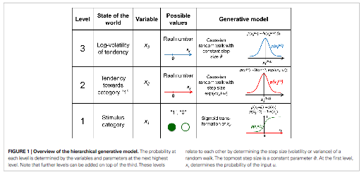
“Random Walk” Hierarchical Model with 3 levels, used for the Re-Cat Model
Change over time is modeled as a nested random walk, with the variance at each level effected by the means of the preceding level.
Notes:
Change over time is modeled as a nested random walk, with the variance at each level effected by the mean of the preceding level.

Slide 45


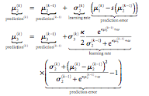
Update Equations Derived from the Hierarchical Model
Definitions
Update Equations for the 2nd and 3rd Model Levels have the form of Reward Learning Equations.
Note: prediction for the first level is as a sigmoid function of the mu_2.

Slide 46
Main Idea: Precision Weighted Prediction Error, derived from hierarchical Bayesian process
Learning rate (precision weighted
prediction error) as attention:
( Friston 2013, Feldman 2010?)

Slide 47
Importance of the Hierarchical Model and Individual Parameters in the Re-Cat task
1. The idea of multiple timescales and/or hierarchies of causes implicit in the hierarchical model suggests a process by which subjects may separate ‘mere’ noisy errors from predictively useful underlying changes.
2. Subjects may differ as to how long they count observed changes as noise, which in turn may effect how quickly they change their predictions/explicit theories.
3. Individual parameters that effect assumptions about the variance at each level of the model (as well as the strength of the coupling between levels), may explain the individual variation mentioned above.

Slide 48
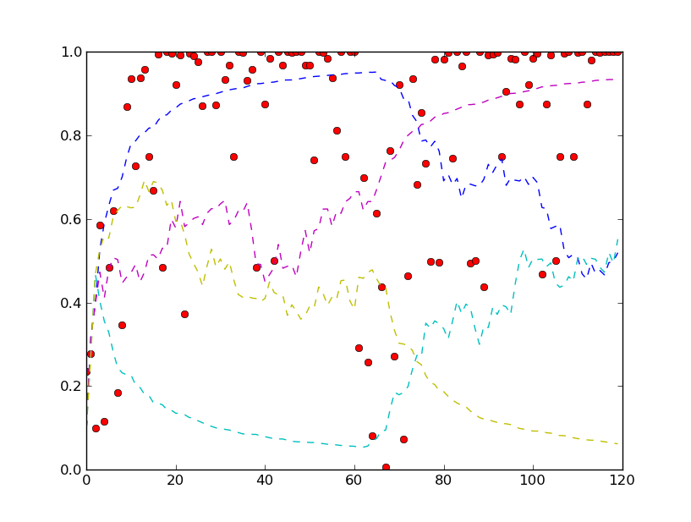
Average Results (120 learners), Simple -> Simple: “Slow” learner, 5 features, 2 categories (02 res, 02 tol), 120 trials each, shift at trial 60
Feature
weight
Blue = misconception, “oxygen resistant” weight
Cyan = misconception, “oxygen in tolerant” weight
Purple = target “oxygen resistant” weight
Yellow = target “oxygen intolerant” weight
Red Dot = percent correct
Per trial (average over
120 learners)

Slide 49
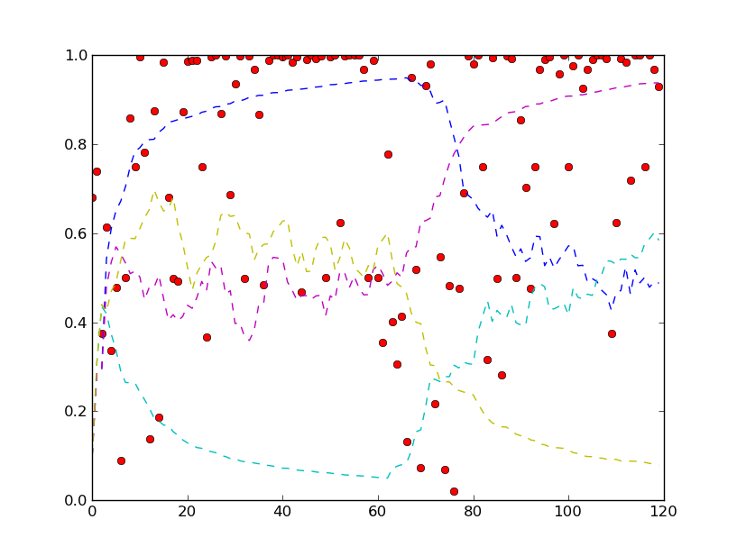
Average Results (120 learners), Simple -> Complex: “Slow” learner, 5 features, 2 categories (02 res, 02 tol), 120 trials each, shift at trial 60
Feature
weight
Blue = misconception, “oxygen resistant” weight
Cyan = misconception, “oxygen intolerant” weight
Purple = target “oxygen resistant” weight
Yellow = target “oxygen intolerant” weight
Red Dot = percent correct
Per trial (average over
120 learners)

Slide 50
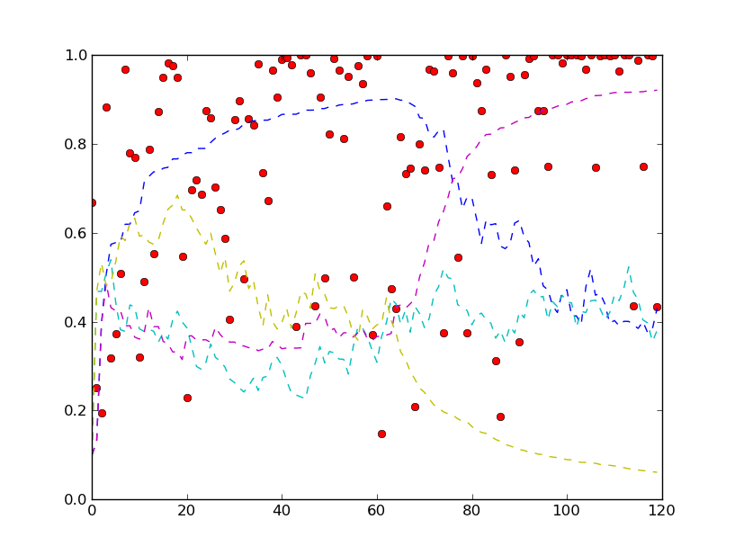
Average Results (120 learners), Complex -> Complex: “Slow” learner, 5 features, 2 categories (02 res, 02 tol), 120 trials each, shift at trial 60
Feature
weight
Blue = misconception, “oxygen resistant” weight
Cyan = misconception, “oxygen intolerant” weight
Purple = target “oxygen resistant” weight
Yellow = target “oxygen intolerant” weight
Red Dot = percent correct
Per trial (average over
120 learners)

Slide 51
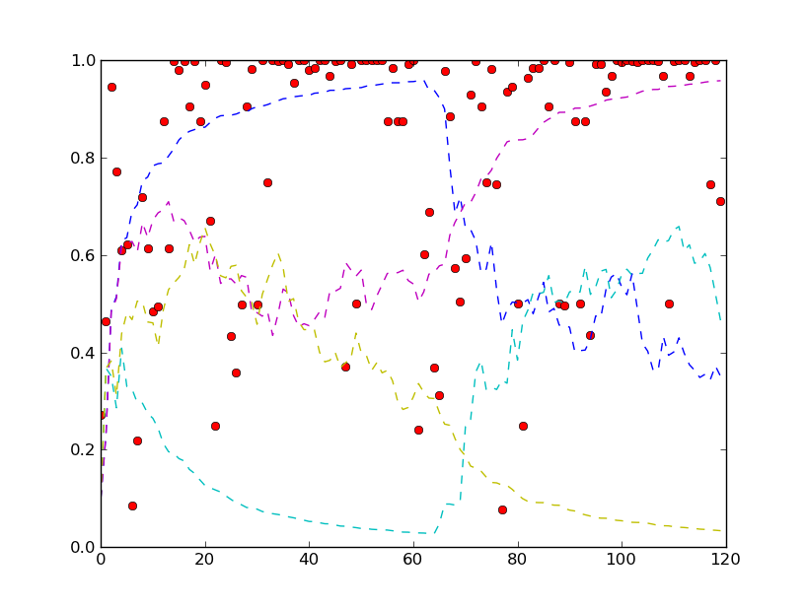
Average Results (120 learners), Simple -> Simple: “Fast” learner, 5 features, 2 categories (02 res, 02 tol), 120 trials each, shift at trial 60
Feature
weight
Blue = misconception, “oxygen resistant” weight
Cyan = misconception, “oxygen intolerant” weight
Purple = target “oxygen resistant” weight
Yellow = target “oxygen intolerant” weight
Red Dot = percent correct
Per trial (average over
120 learners)

Slide 52
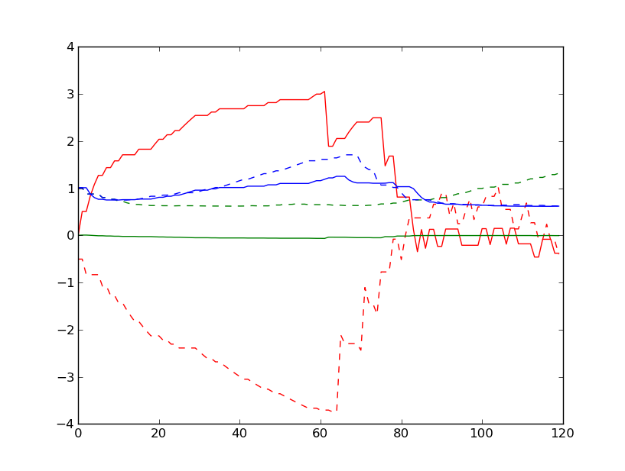
Changes in internal parameter estimates, simple -> simple, fast learner (1), 120 trials, misconception
Dotted lines = intolerant
Solid lines = res
Red = feature weight (mu_1)
Blue = inferred environmental volatility (mu_3)
Green = precision weighted prediction error, learning rate (sg_2) (attention?)

Slide 53
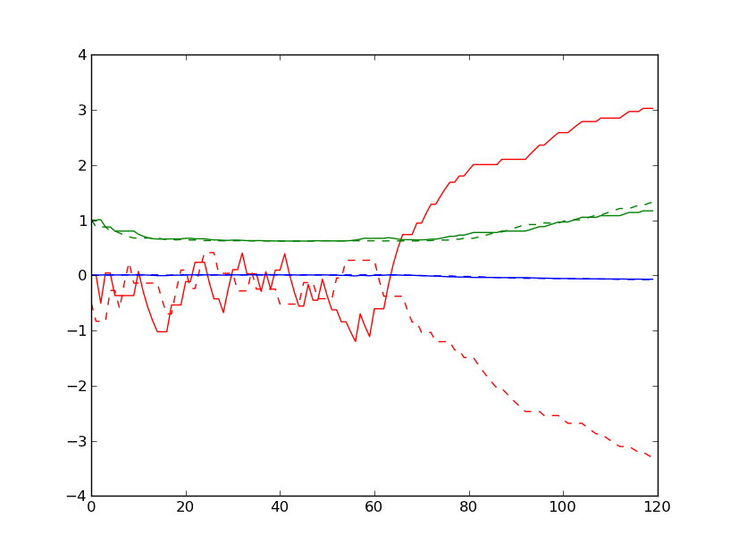
Changes in internal parameter estimates, simple -> simple, fast learner (1), 120 trials, target
Dotted lines = intolerant
Solid lines = res
Red = feature weight (mu_1)
Blue = inferred environmental volatility (mu_3)
Green = precision weighted prediction error, learning rate (sg_2) (attention?)

Slide 54
Model finding Prediction Error (Simple)

Slide 55
Model findings: feature weights, prediction error, precision (drivers of non-monotonic change) (Speed-up in RT, precision?)

Slide 56
Wrap-up: What does the model explain?

Slide 57
Reaction time speed up after shift
Attention increases speed/accuracy (cite)
(Attentional) Salience can be driven by conflict
Precision weighted prediction error: Pay attention to “meaningful changes”
Sigma₂ is precision weighted prediction.

Slide 58
Future Directions
Biological correlates? (Rough Sketch?), fit w/existing lit
Sketch of correlates (dopamine, brain regions)
2. Maks model
Comparison with other models. (AIC/BIC, F ratio, linear models- model selection, COVIS, etc.)
Unexplained stuff?

Slide 60
Feature 1 Value 1
Feature 1 Value 2
Feature 2
Value 1
Feature 2 Value 2
Category 1 (total strength)
Category 2 (total strength)
Compete for action
selection
(relative strengths

